Slide 1

Welcome to essens
Essens Business Presentation

Slide 2
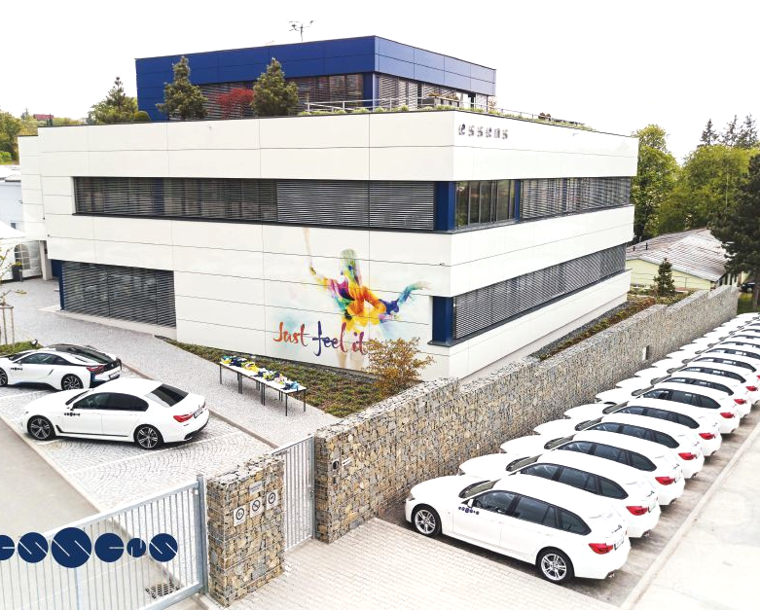
New to the UK
Essens was founded in 2011 in Brno in the Czech Republic by Michal Kovar. and has experienced substantial growth throughout Europe.
Essens first appeared in the UK in 2017, but only opened it’s first UK office on 6th March 2019, based in Risley near Warrington.

Slide 3
Do You Want Financial Freedom?
Wouldn’t it be great if you never had to worry about money again?

Slide 4

A Great Opportunity
Essens represents a fantastic opportunity to improve your financial situation and your quality of life.
As a member you decide when, where, with whom and, most importantly, How you wish to work.
Opportunities like this don’t come around very often and now is the time to get on board.

Slide 5
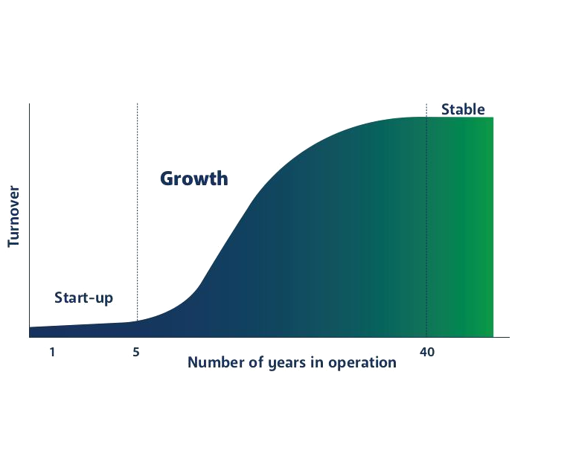
Right Place, Right Time
Essens growth period is still ahead of them.
You would be joining at the best time to take part in that growth
Act now!

Slide 6

Different Membership levels
Buy as a customer and enjoy discounted member prices
Sell our products to family & friends or neighbours. Sell door to door, on stalls, at parties or online and receive retail profit starting at 28.5%
Build a team and enjoy commission up to 28% on top of retail profit both on your own sales, and on the group sales of your entire team

Slide 7
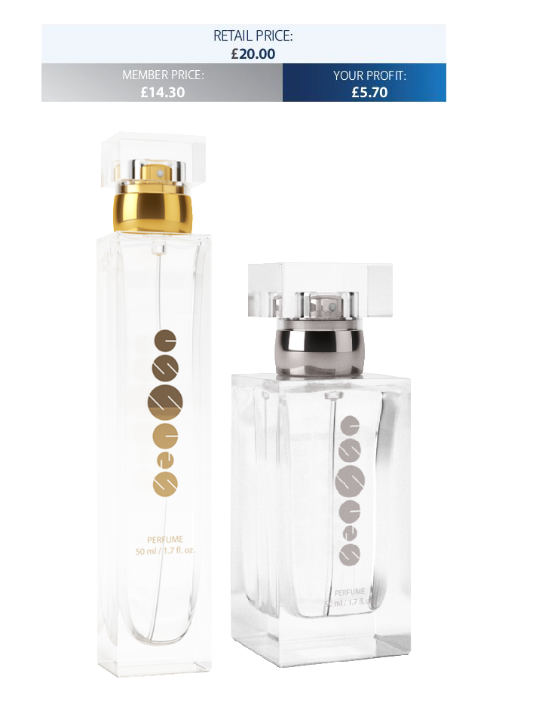
Retail Profit
Each perfume or men’s fragrance retails at £20.
The member price is £14.30, giving profit of £5.70.
Sell 9 bottles pay only for 8 bottles – 1 free
Sell 16 bottles pay only for 14 bottles – 2 free
Sell 21 bottles pay only for 18 bottles – 3 free
Sell your free bottles and make £20 profit per bottle
e.g. sell 21 bottles, 18 X £5.70 + 3 x £20, make £162.50 profit or 38.5%.

Slide 8
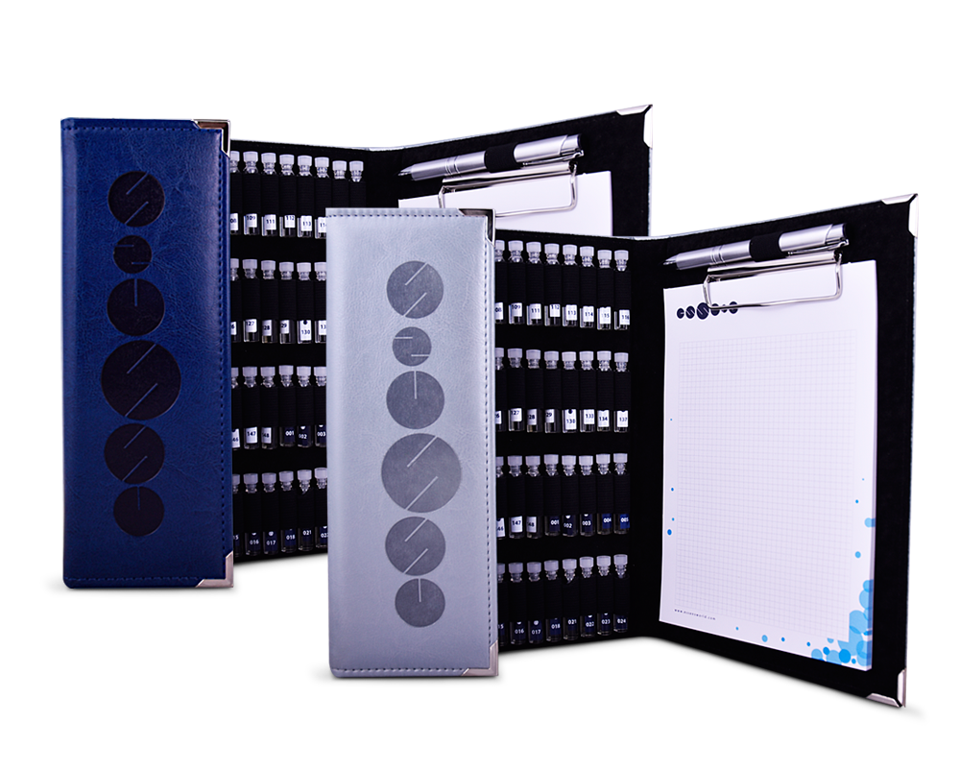
Starter Kits are the Key to Your success
Leave your kit with customers or prospective team members.
Wear the perfumes yourself
Carry your kit with you to demo to customers whenever they engage in conversation with you
Aim for one perfume sale each day = 30 perfumes per month

Slide 9
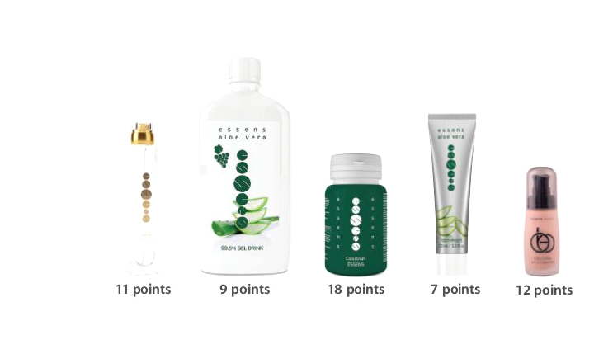
Points equal commission
Each product has a points value which broadly equals the value in £’s at member price less VAT
We call these volume points and they accumulate throughout each calendar month and determine your additional commission.

Slide 10
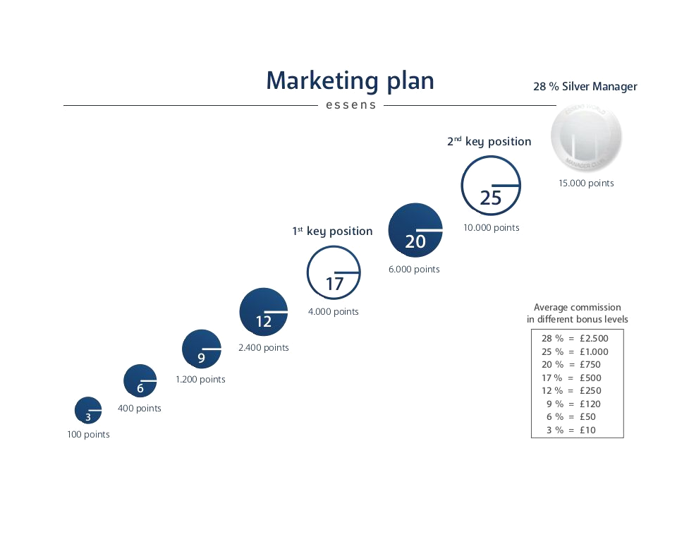
Points equal prizes
As you accumulate points throughout the month you will move through the different levels of the marketing plan
17% is the first key position at which you can win the holiday and qualify for the car scheme
25% is the 2nd key position at which you can win an additional 3 day break and qualify for a luxury car

Slide 11
Points equal shipping discounts
Orders are delivered by DPD for next day delivery. The cost is £6
50 points = £3 P&P - 50% discount
100 points = free shipping

Slide 12
Do you want to be comfortable for the rest of your life?
Would you like to be able to buy the things you want without having to wonder where you will get the money from?
Would you like to be able to spend more time with the people you love doing the things you love?

Slide 13
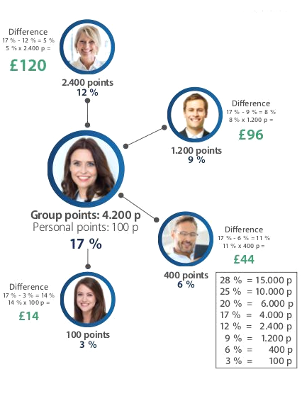
Build a team for greater benefits
Your group points determine your overall level of commission at the end of each month
Earn full rate commission on your own points
Earn the difference between your overall level of commission and the level of commission each of your downlines has earned according to their own personal points during the month

Slide 14
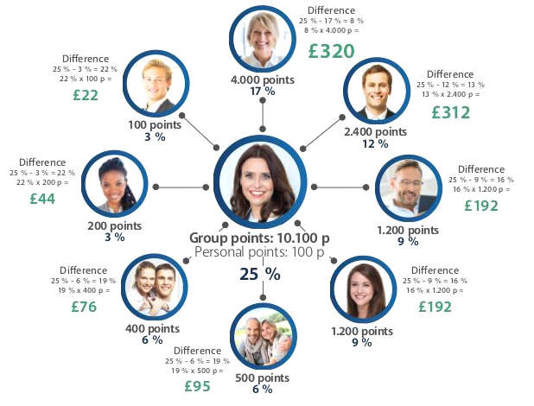
Continue to build for bigger benefits
Encourage your downlines to build teams of their own
Earn not just on the people you recruited yourself but also on the team(s) your recruits have built
Never stop recruiting
The more people you recruit the more group points you accumulate

Slide 15
Do you like added bonuses?

Slide 16
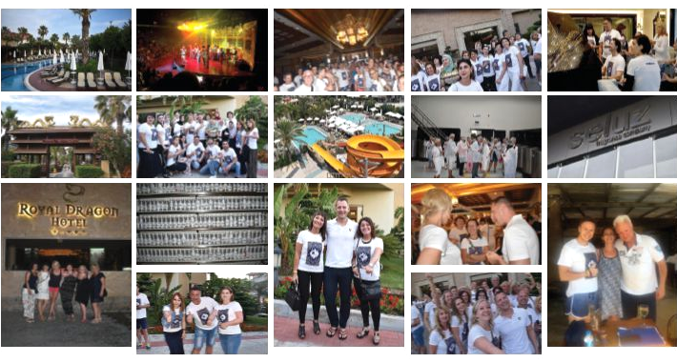
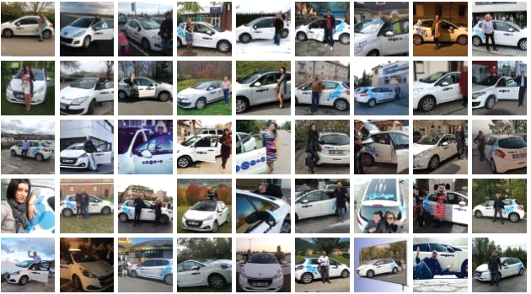
17% - 1st Key position benefits
At the 1st key position with £300 in commission you can win a 5* all inclusive holiday, if you can achieve that position 3 times between October & February
…and if you can hold that position for 2 months in a row with a minimum of £300 in commission you can apply for a Peugeot 208

Slide 17
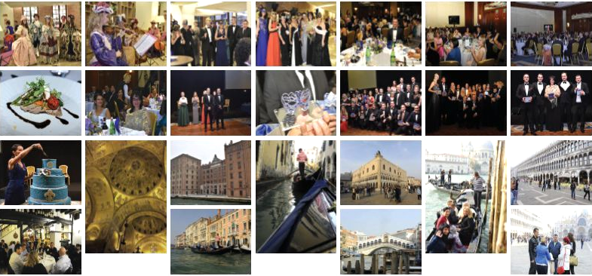
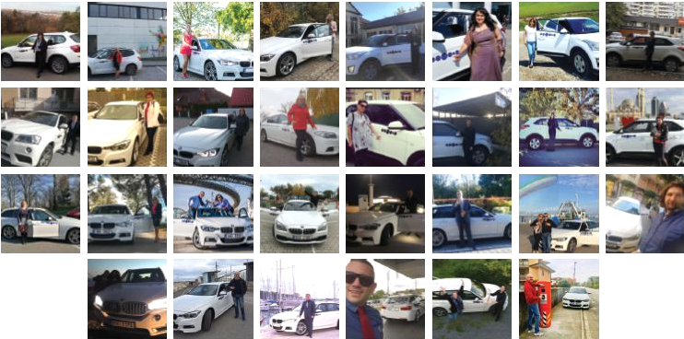
25% - 2nd Key Position Benefits
At the 2nd key position with a minimum of £700 commission you can also win an exclusive 3 day event if you hold that position in June, July & august
…and if you hold that position for 2 months in a row with a minimum of £1,000 in commission you can apply to drive away a BMW 320d

Slide 18
It All Starts here
A starter kit costs £26 plus P&P of £6 so with an initial investment of £32 you can start benefitting from this fantastic opportunity
A small investment, which will pay for itself if you were to sell only 6 bottles

Slide 19
Are you ready to take the next step that could change your life?
Register now at:
www.essens.co.uk/registration.php
You will need my sponsor ID which is: 1010032947

